Slide 1

8051 Architecture (8051 -5 Days Workshop)
DAY 6
EMBEDDED SYSTEM DESIGN & IoT-Master Class

Slide 2
What You will learn Today?
Introduction to Microcontroller Vs Microprocessor
Types of Microcontroller
Microcontroller Architecture
Features of Microcontroller
8051 Block Diagram
8051 PIN Diagram
Registers in 8051
Ports
Timers and Counters
Interrupts ,Priorities
Embedded system design using 8051

Slide 3
Mindset Lesson for the Day
If you think in Positive Terms you will get Positive results.
If you think in negative terms you will get negative results.
Exercise
Write down all the people or things in your life that affect you in a negative way.

Slide 4
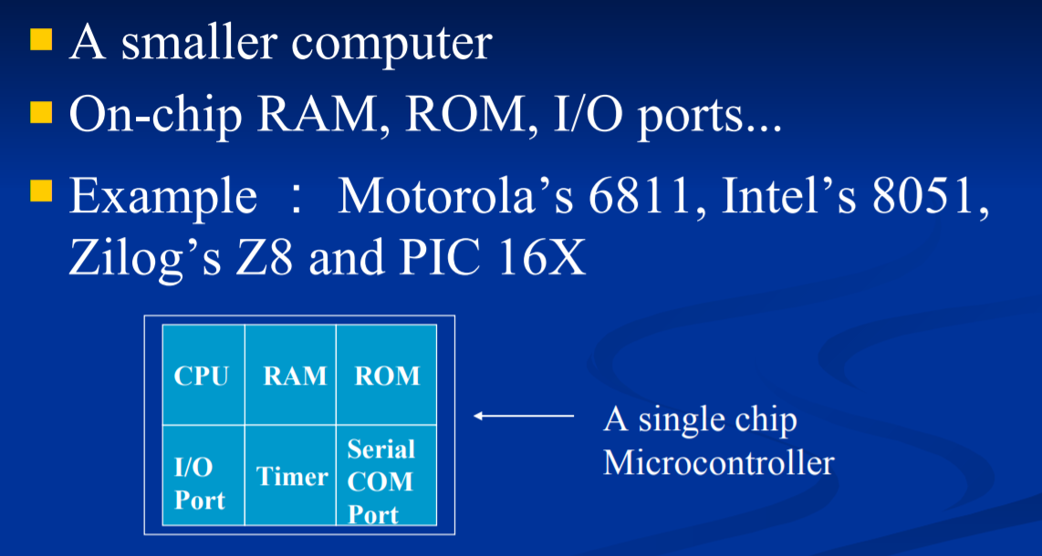
What is a Microcontroller

Slide 5
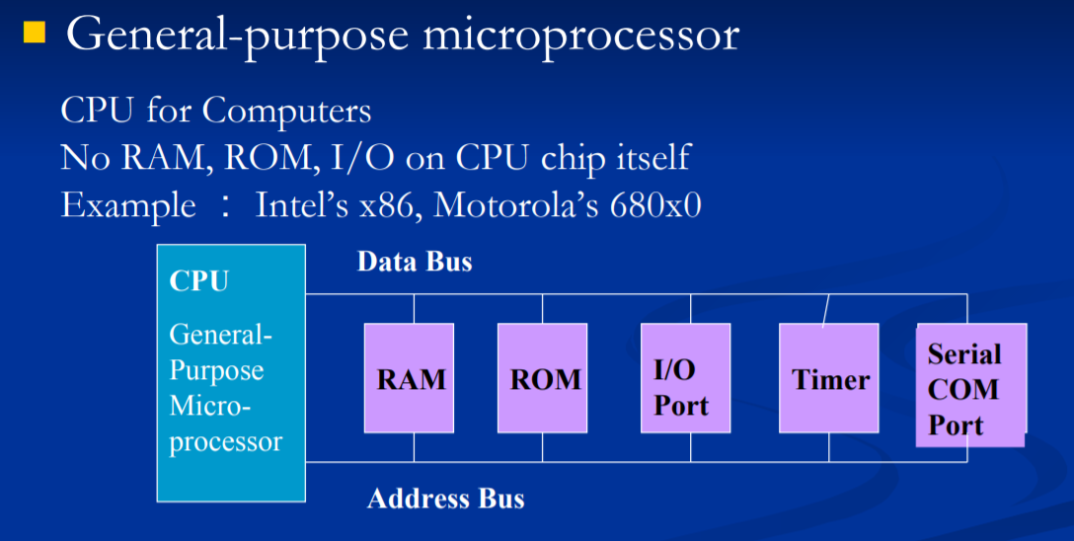
How it is different from Microprocessor

Slide 6
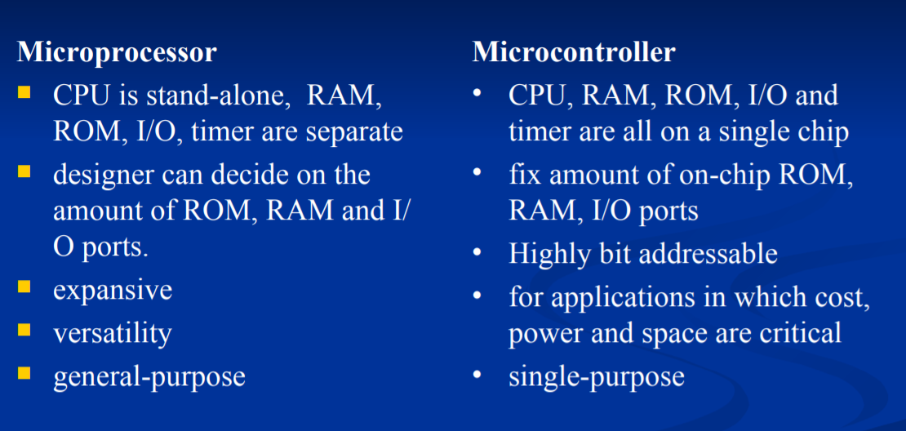
Microprocessor Vs Microcontroller

Slide 7
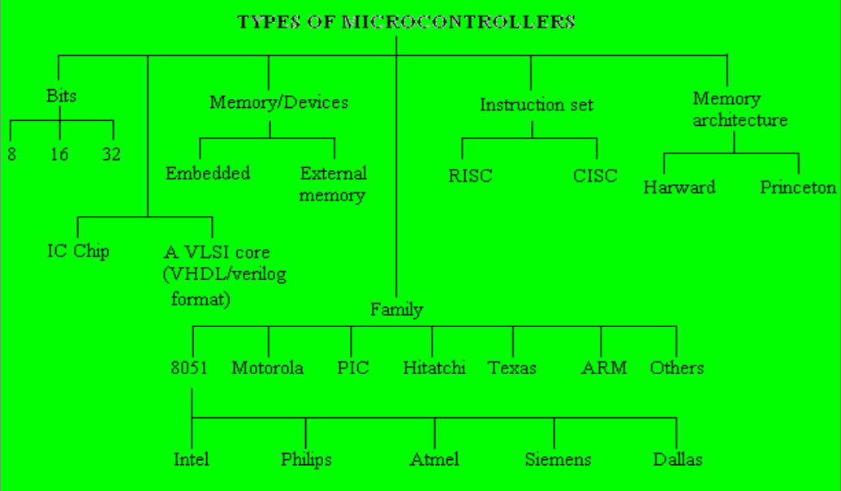
Types of Microcontroller

Slide 8
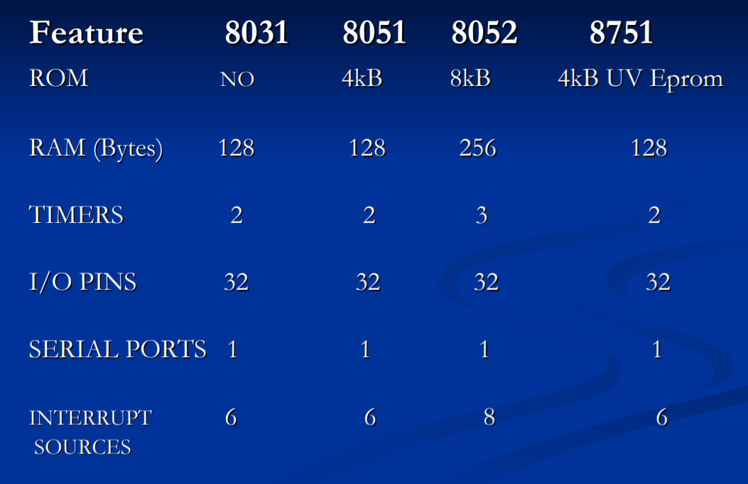
8051 Family of Microcontrollers

Slide 9
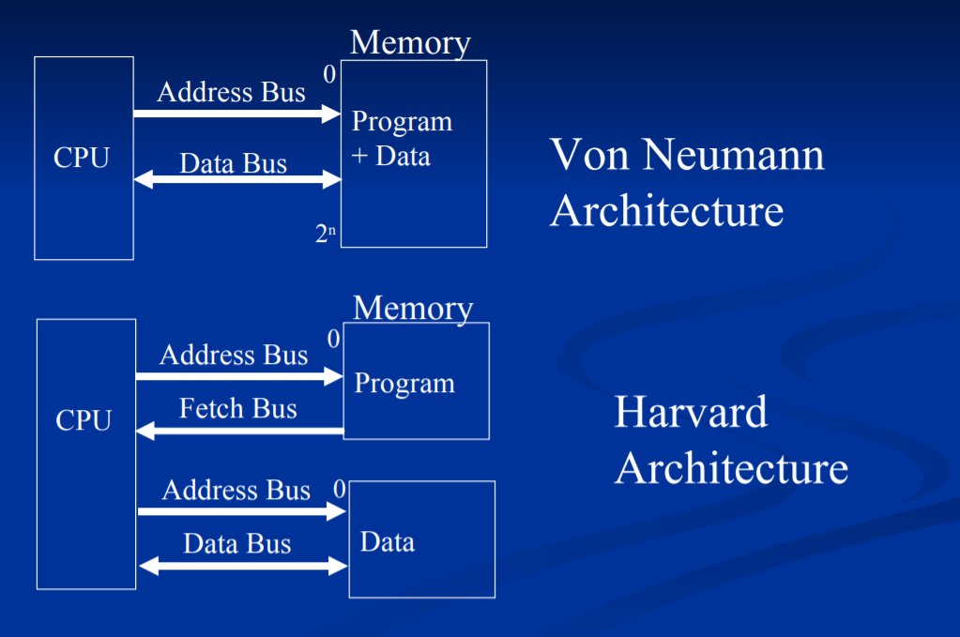
Microcontroller Architecture

Slide 10
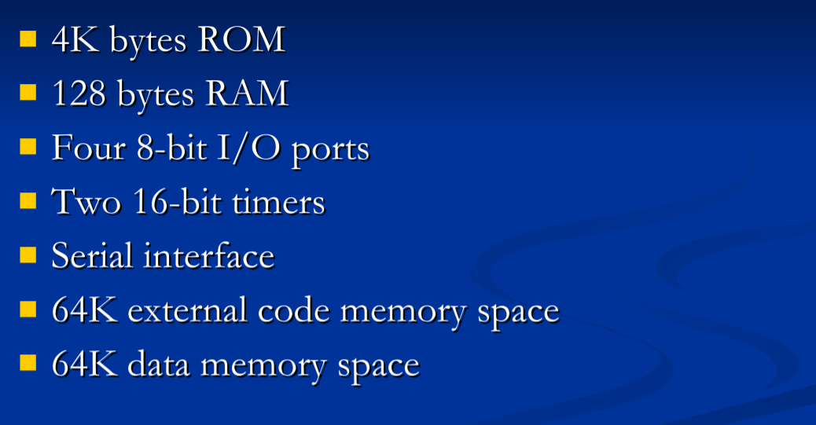
Important Features of 8051

Slide 11
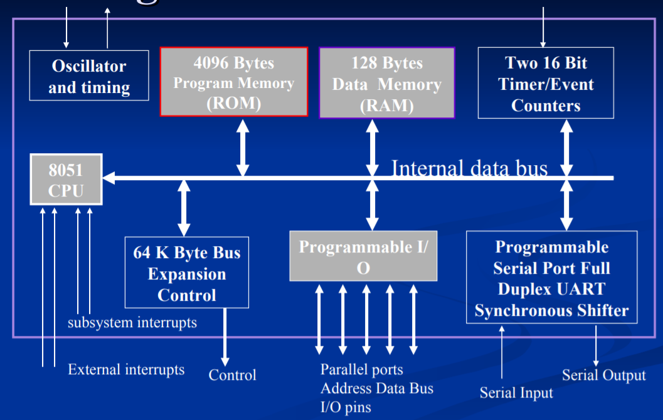
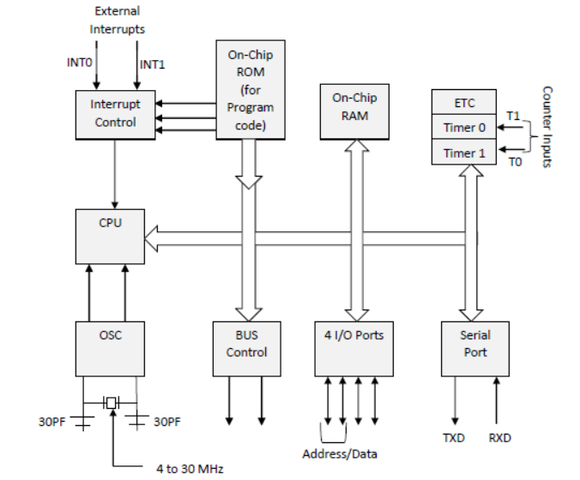
8051 Microcontroller –Block diagram

Slide 12
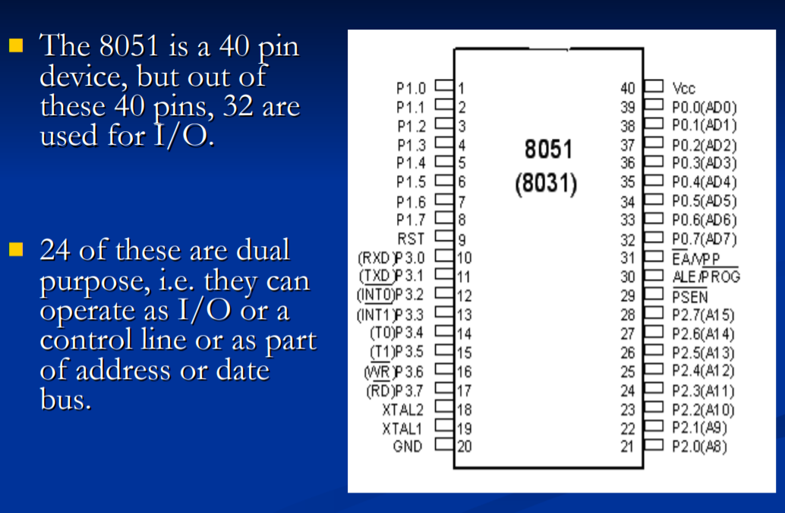
8051 Pin

Slide 13
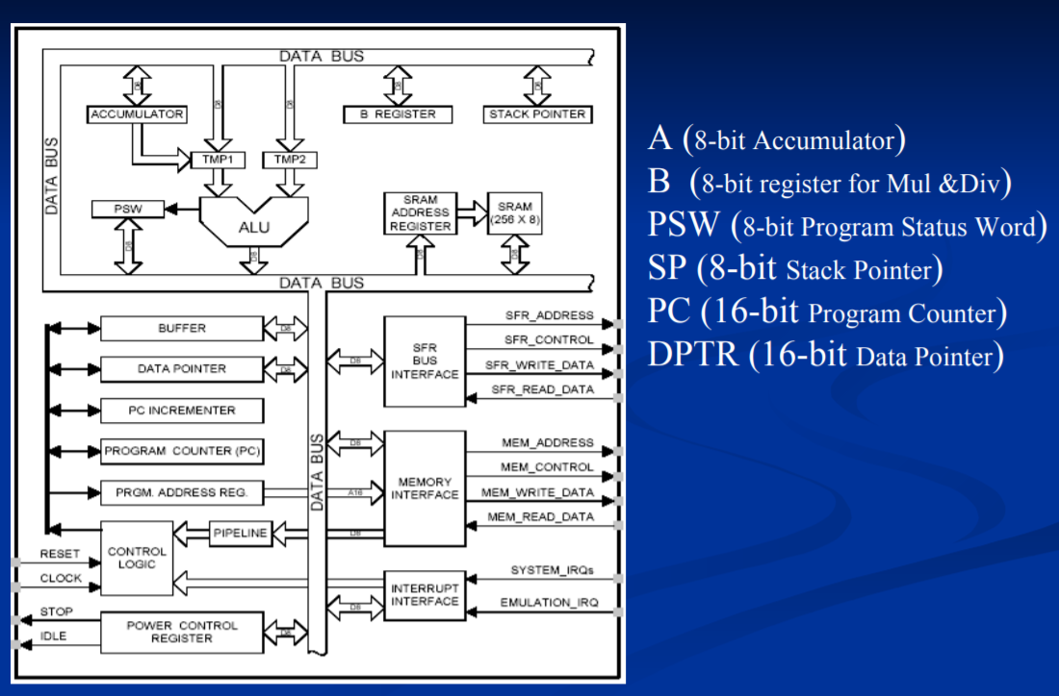
8051 CPU Registers

Slide 14
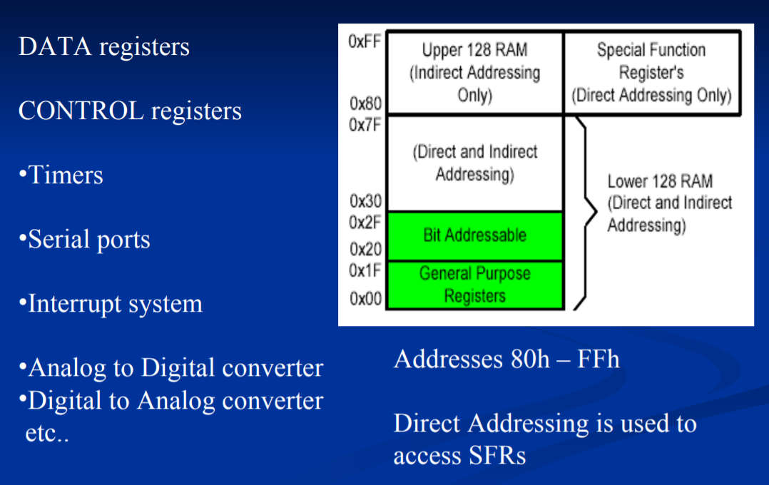
Special Function Registers

Slide 15
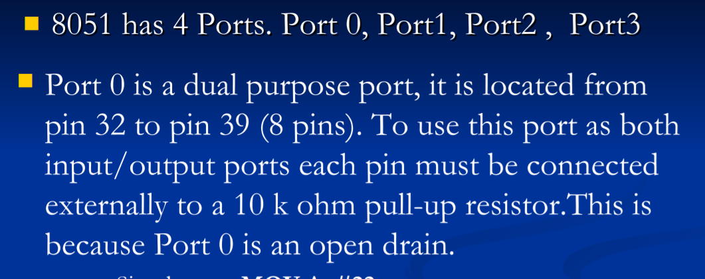
Ports of 8051

Slide 16
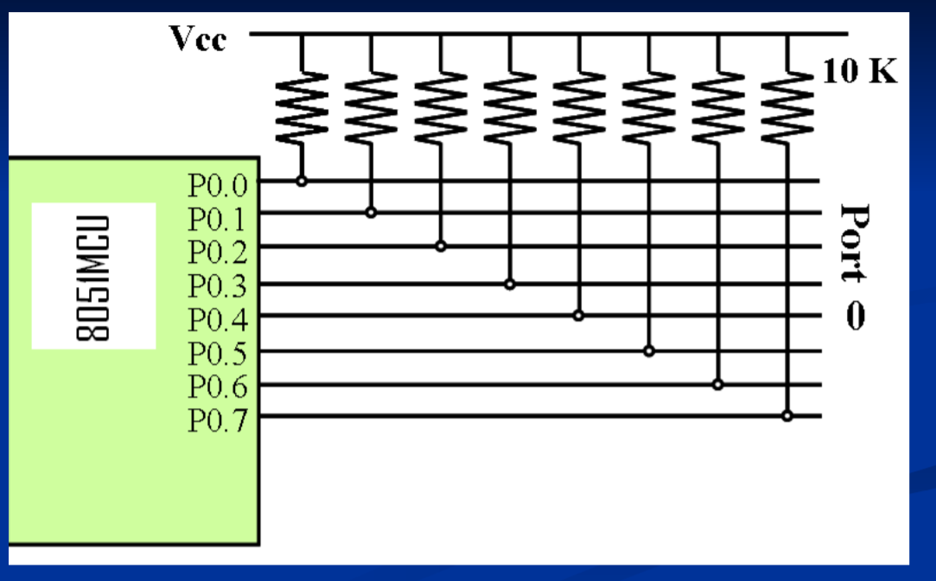
Port 0 with pull up resistor

Slide 17
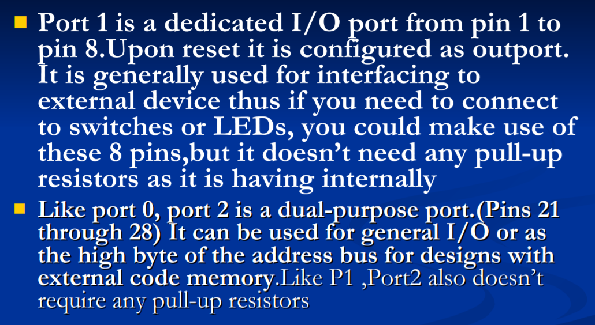
Ports…

Slide 18
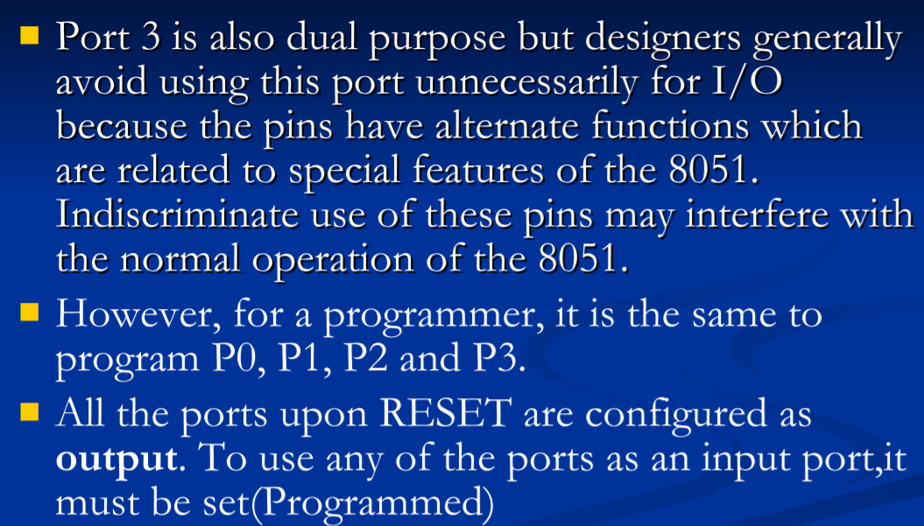
Ports..

Slide 19
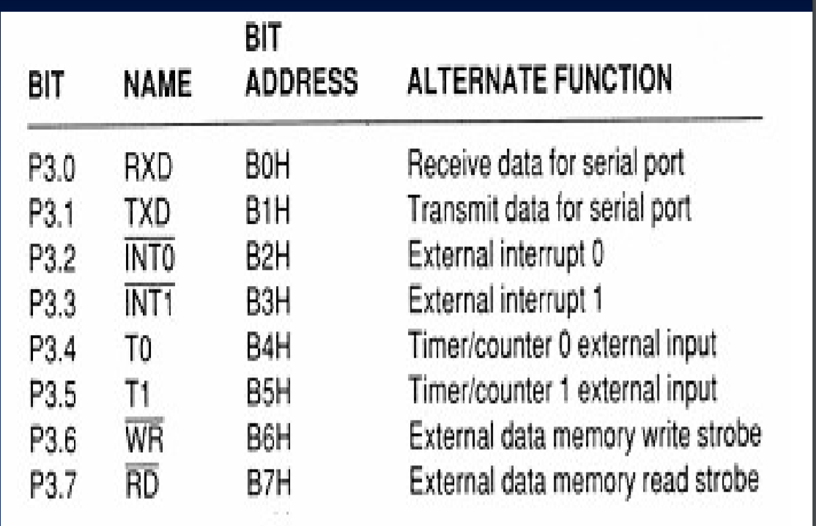
Alternate Function of P3

Slide 20
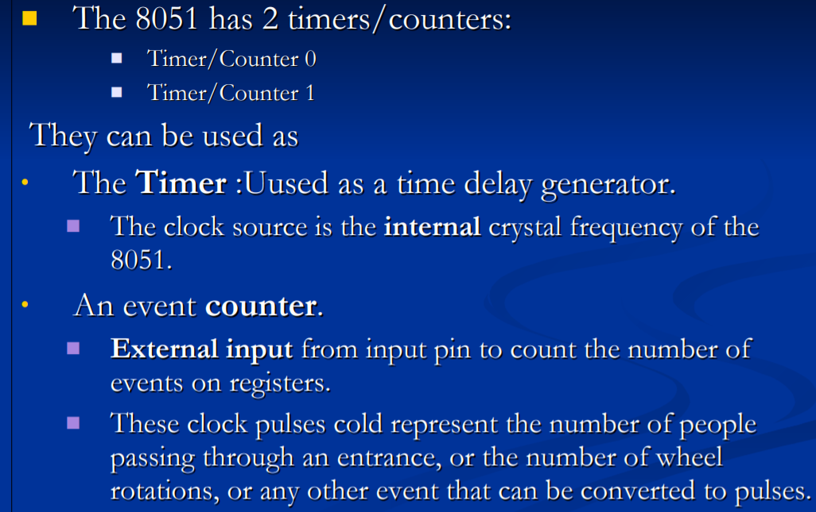
Timers and Counters

Slide 21
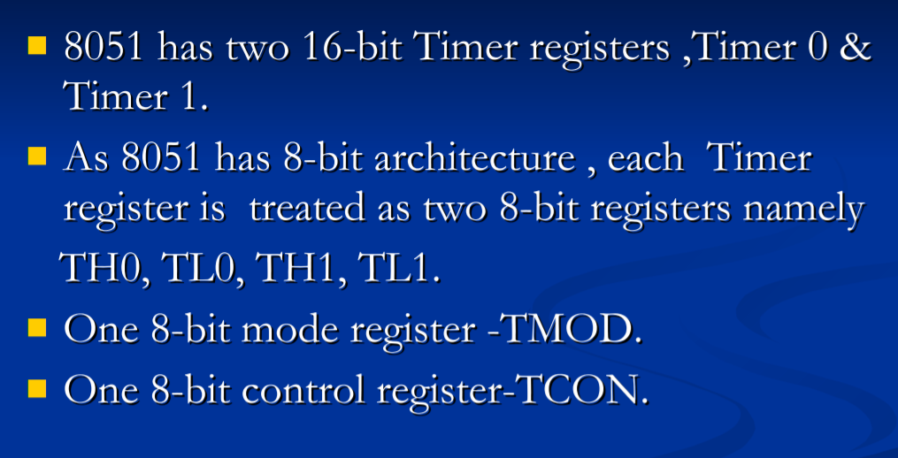
Registers used in Timer and Counter

Slide 22
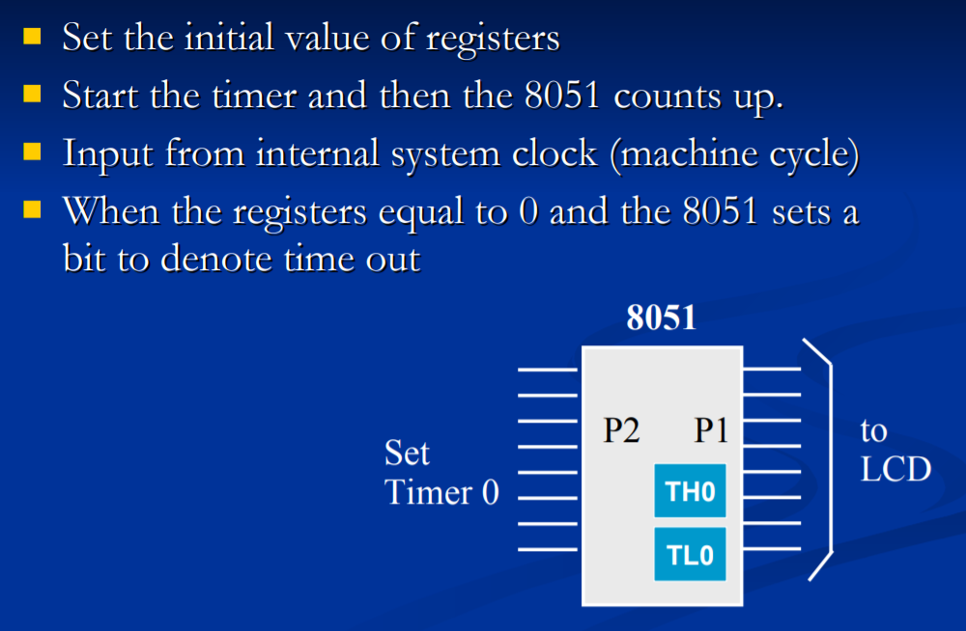
Timer

Slide 23
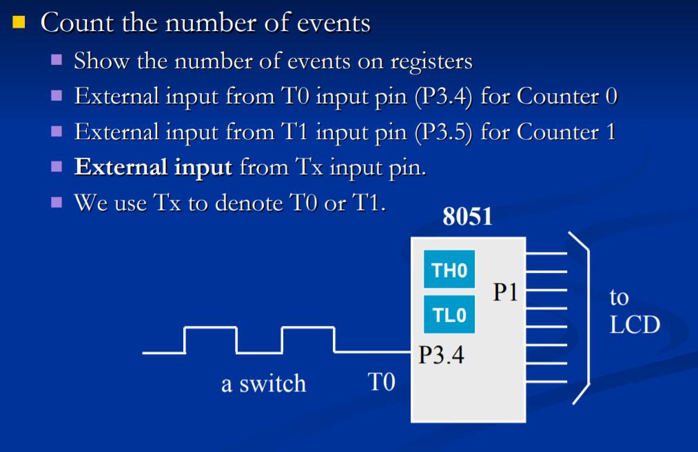
Counters

Slide 24
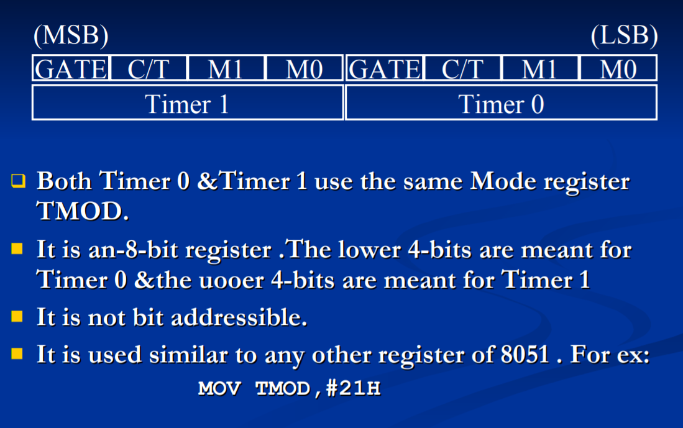
TMOD Register

Slide 25
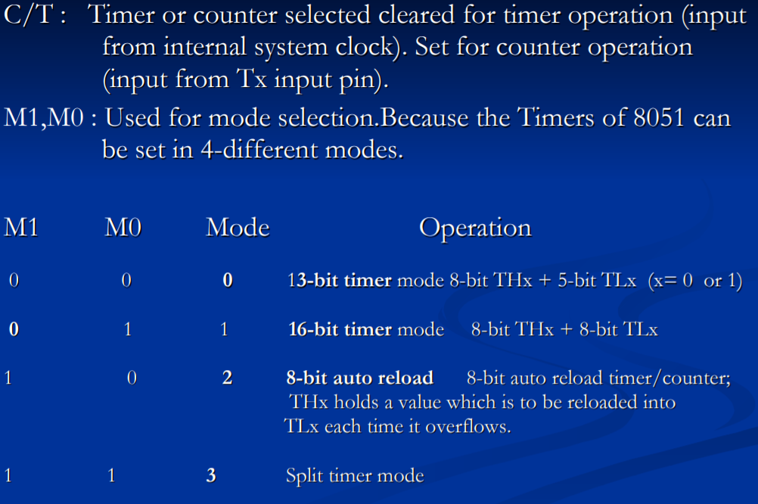
Timer Modes

Slide 26
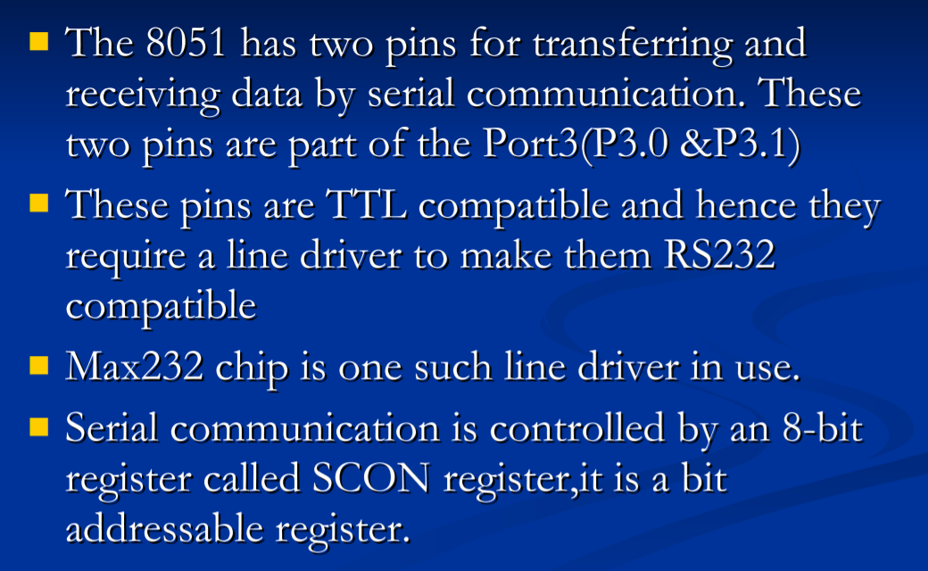
RxD and TxD pins in the 8051

Slide 27
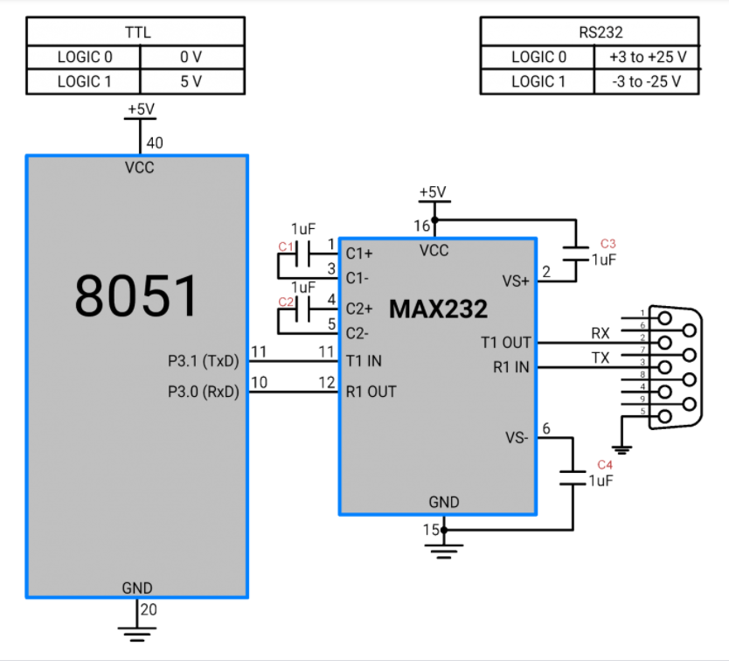
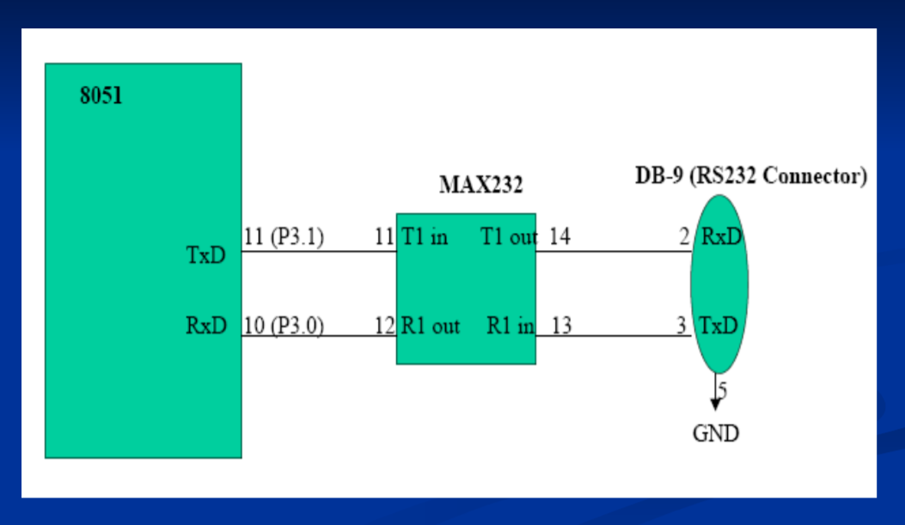
Interfacing to PC

Slide 28
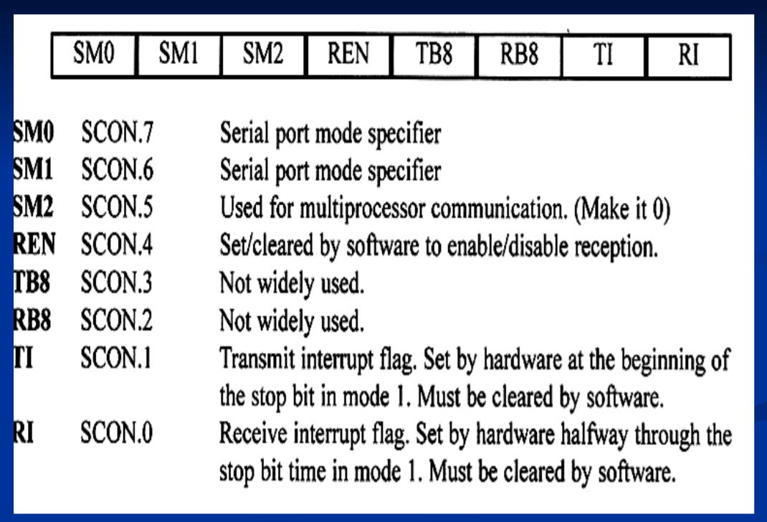
SCON( Serial Control Register)

Slide 29
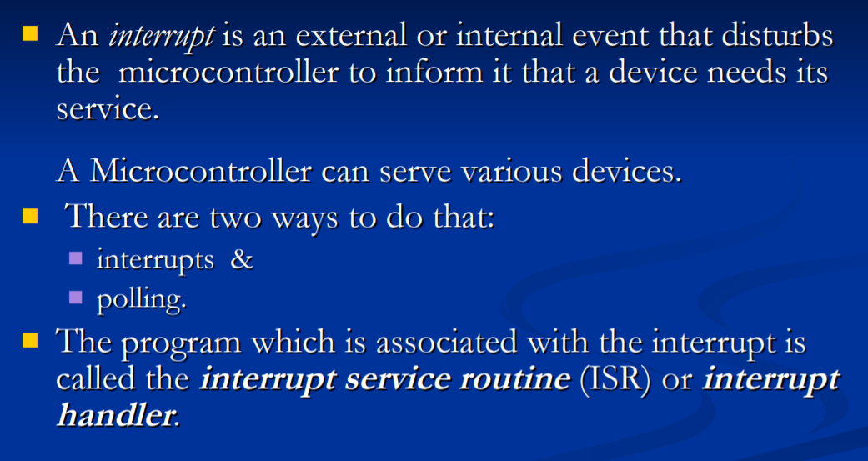
8051 Interrupts

Slide 30
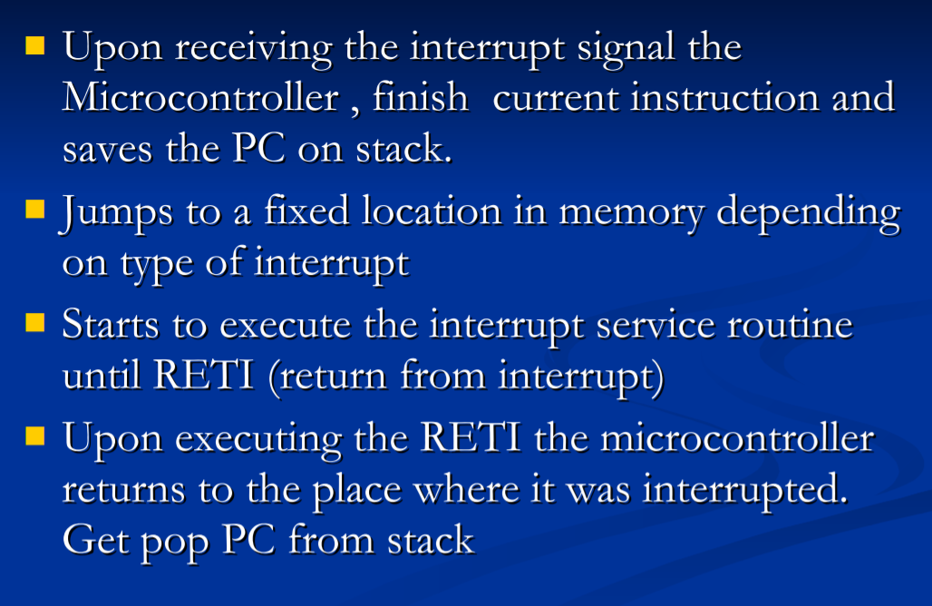
Steps in Executing an Interrupt

Slide 31
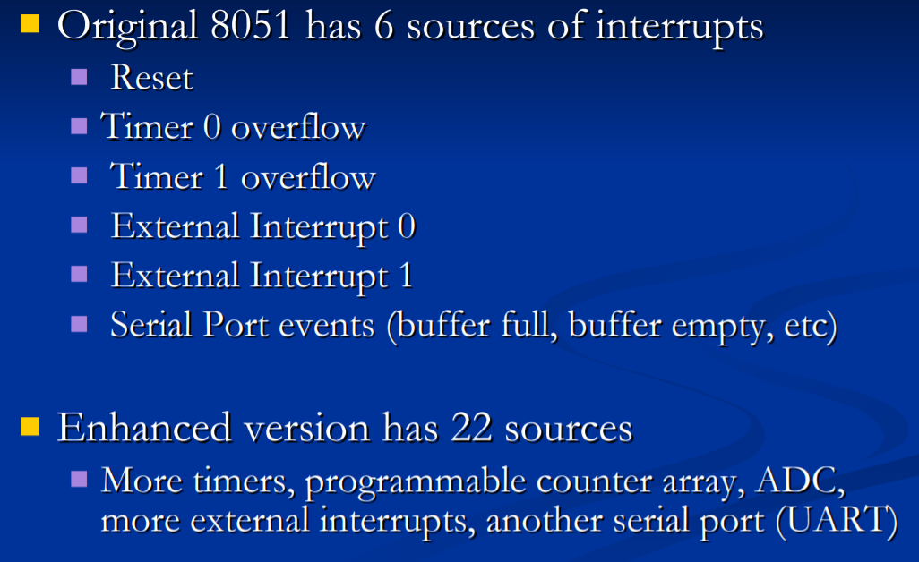
Interrupt Sources

Slide 32
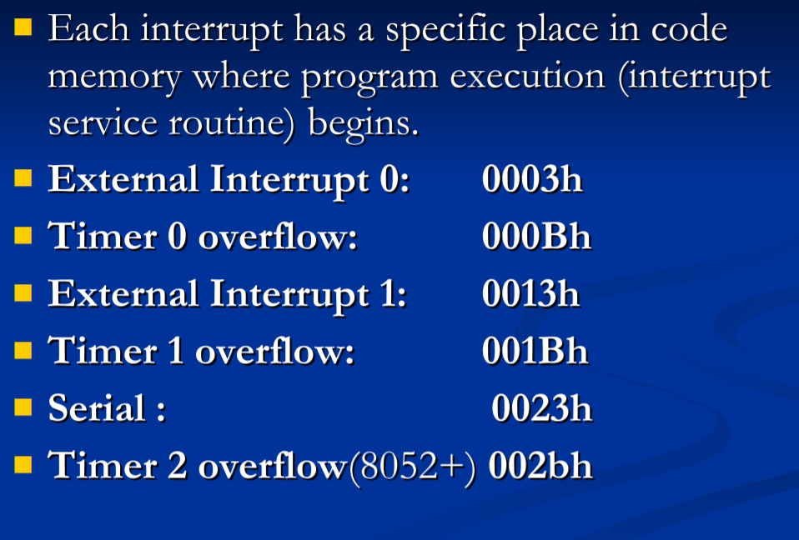
Interrupt Vectors

Slide 33
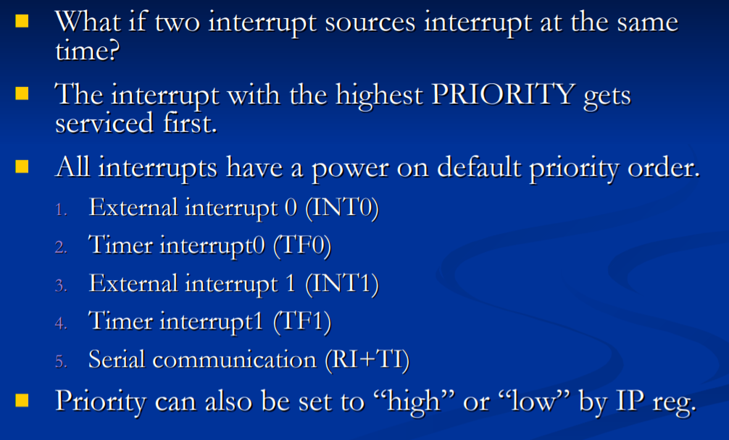
Interrupt Priorities

Slide 34
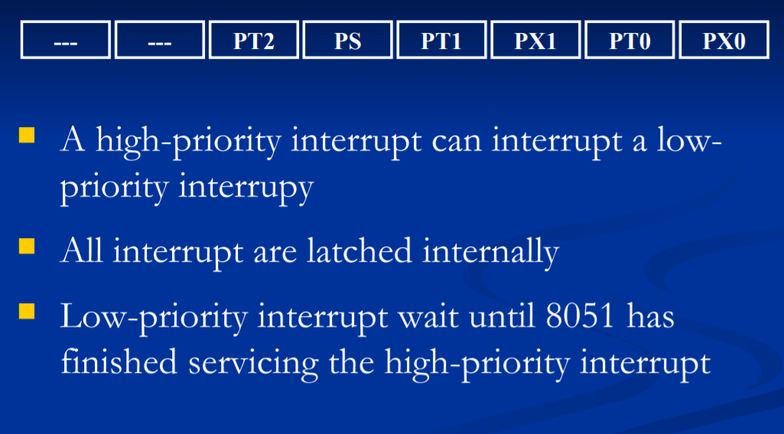
Nested Interrupts

Slide 35
ESD USING 8051

Slide 36
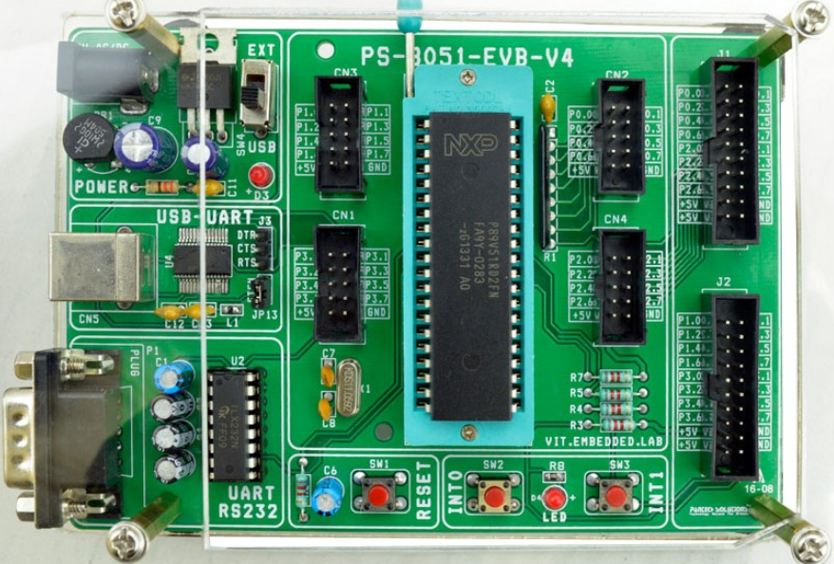
8051 Board

Slide 37
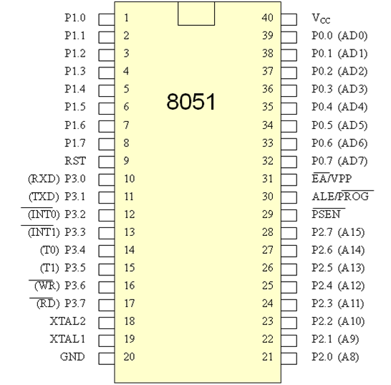
8051- Processor Symbol
DATASHEET

Slide 38
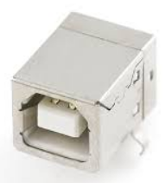
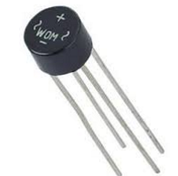
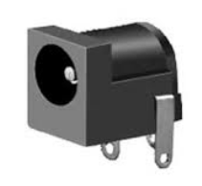
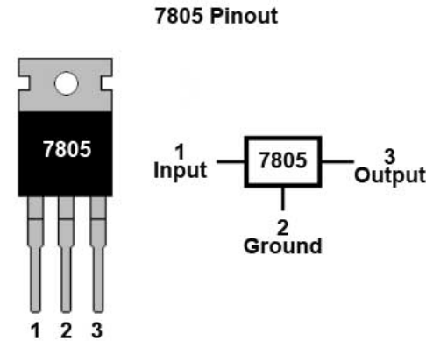

Power Supply Design

Slide 39
Power Supply Design for 3.3 V and 1.8 V

Slide 40
Connection of Power supply and GND

Slide 41
Reset

Slide 42
Crystal

Slide 43
External pull up for Port 0

Slide 44
UART

Slide 45
CONNECTION OF EA ,PSEN

Slide 46
FT232 USB-UART CONNECTION

Slide 47
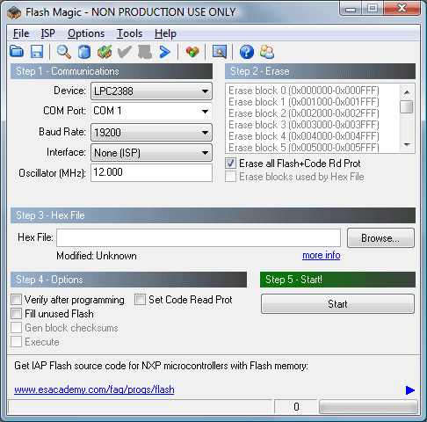
Programming

Slide 48
LED Interface

Slide 49
LCD Interface

Slide 50
Temperature sensor and Buzzer Interface

Slide 51
Seven Segment Interface

Slide 52
Relay and Stepper Motor

Slide 53
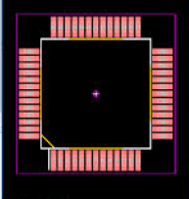
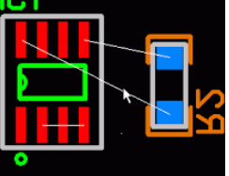
PCB Foot prints

Slide 54
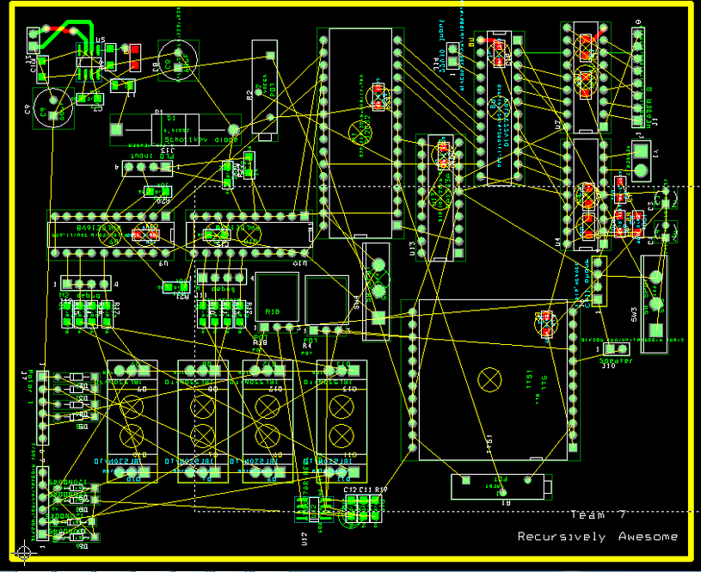
Unrouted PCB Board

Slide 55
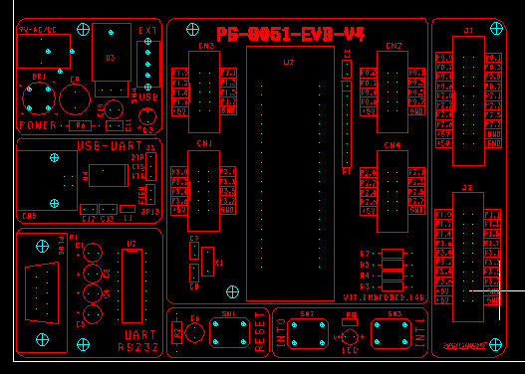
Legend

Slide 56
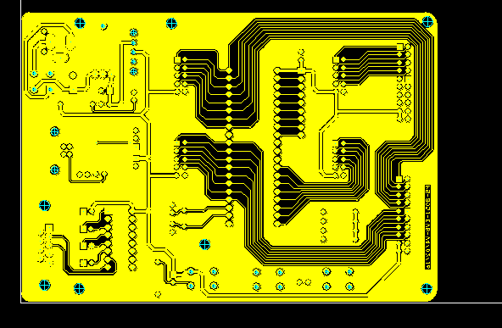
Bottom layer -Routing

Slide 57
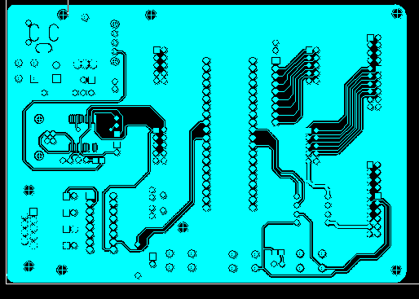
Top Layer-Routing

Slide 58
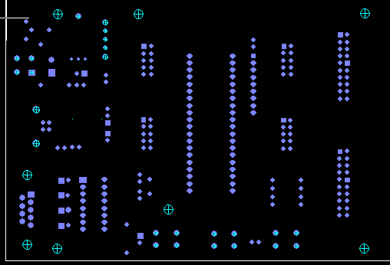
Drill chart

Slide 59
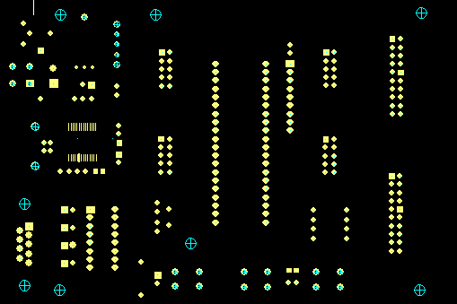
Solder Mask -Top

Slide 60
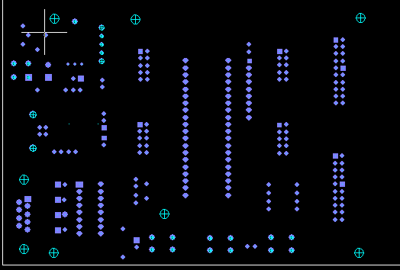
Solder Mask -Bottom

Slide 62
Thank You

